Slide 1

Rent Quest
Your Quest, Our Analysis
U.C.Berkeley Bootcamp Apr 2019
Prem Ganesh, Amitava Samaddar, Jason Zelaya
& Suvrangshu Ghosh

Slide 2

Finding a perfect rental at Bay Area
What are the best areas to search?
Which rentals have the most rooms available
Which locations have more availabilities?

Slide 3

Our Quest
We pulled rental data from a major web site:
Craigslist.org

Slide 4

API calls to web
Called API’s to obtain rental data
Picked multiple locations within the Bay Area that have available rentals
Processed more than 14,000 records

Slide 5

Data Selection & cleanup
Cleanup process
Selection Process
Multiple data scan
Removed special characters
Removed null values
Text to integer conversion
Description
Price
Location
Number of rooms
Geo Tags

Slide 6
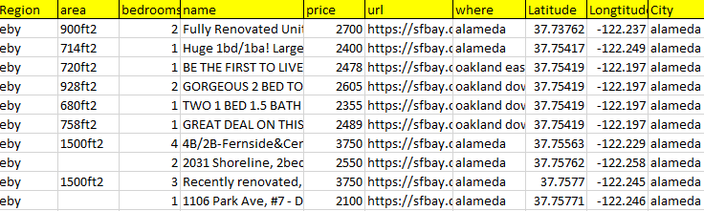
Final Data
The data is converted and stored in MongoDB
Craigslist

Slide 7

Problems faced
Collected data had latitude/Longitude in parenthesis
No proper city
Had to call city py to with lat/lon to get city
D3 library version issues
Leaflet taking long time to load for 14K+ data

Slide 8
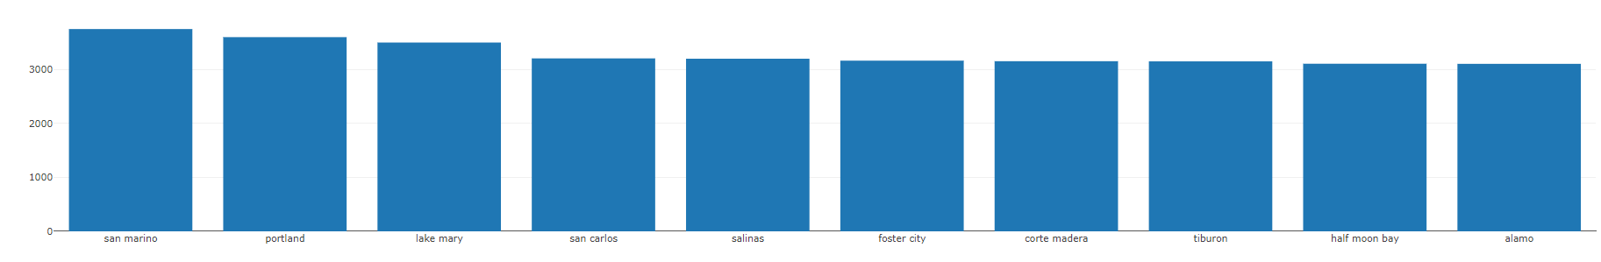
Benefit
Availability Vs Locations
Multiple analyses can be derived the data obtained
Which locations have cheap rentals?
Which locations have higher rental prices?
Average Price

Slide 9
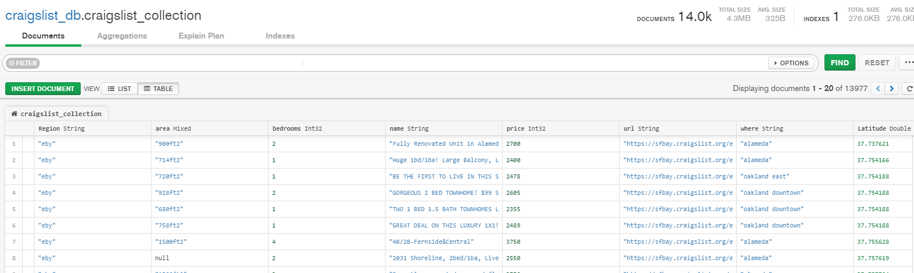
Database - mongodb
Showing collections Craigslist

Slide 10
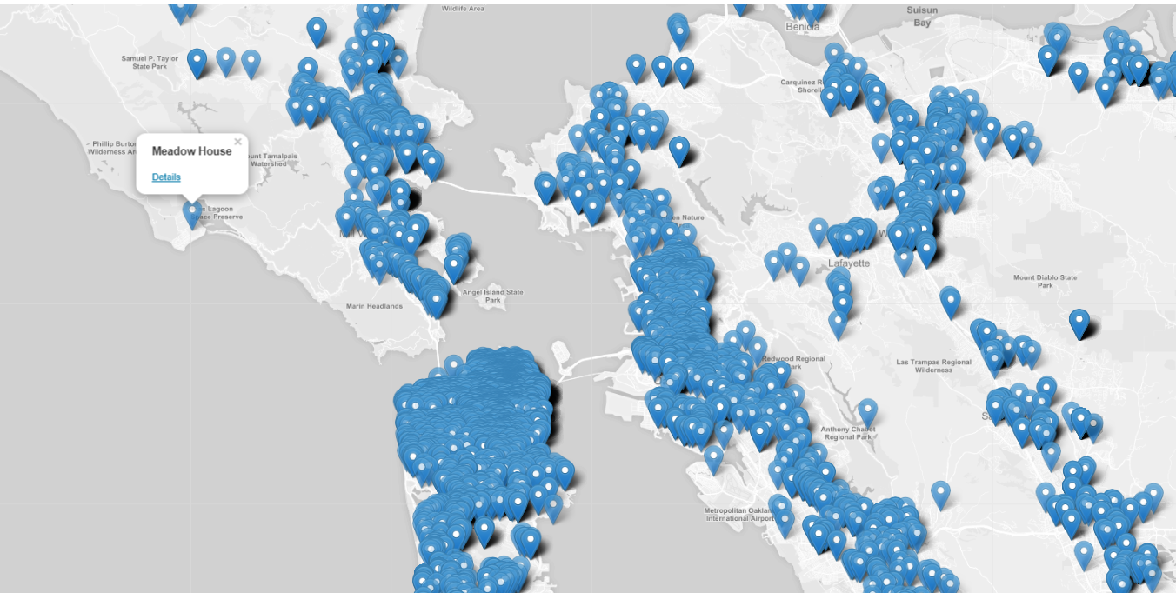
Data visualizations using D3, Leaflet

Slide 11

THANK YOU!

